Slide 1
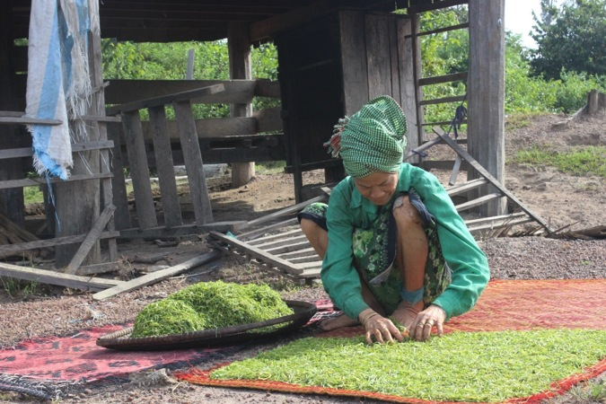
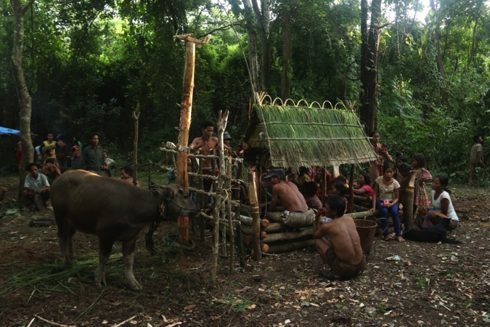
Impact Assessment of HAGL Project on Indigenous Communities
Presented by Thuon Ratha
October 06, 2014

Slide 2
Background
World Bank Group
IFC
Dragon Capital
HAGL
Between 2002-2006, IFC made a series of investments in Dragon Capital, a private equity fund in Vietnam.
Dragon Capital is a major investor in the Vietnamese company Hoang Anh Gia Lai (HAGL).
In recent years, HAGL has acquired tens of thousand of hectares of land in Cambodia to develop rubber plantations.

Slide 3
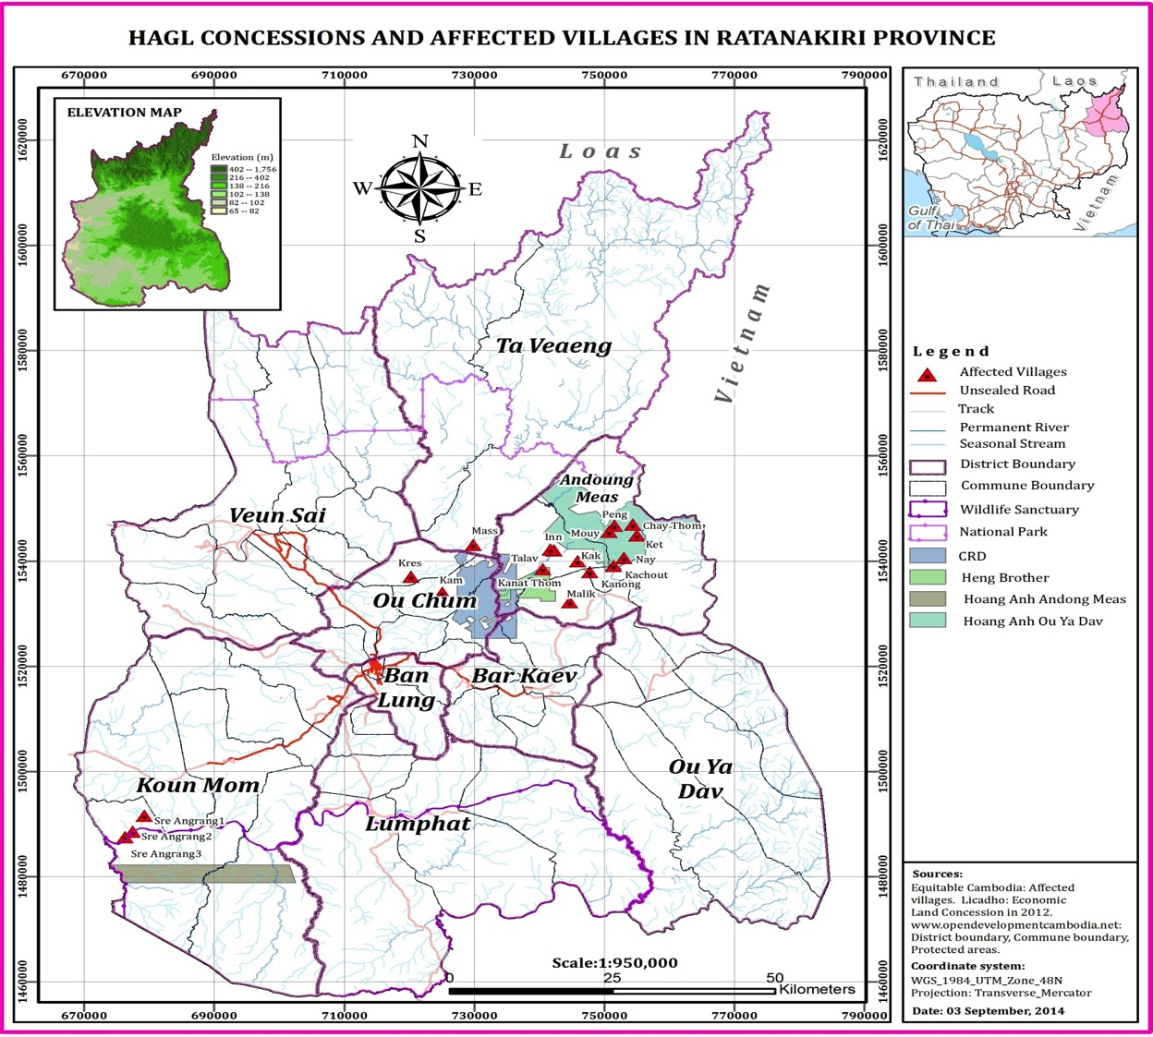

Slide 4
Research Methods
No | Tools | Number (13 affected vil.)
01 | Key informant interview | 13
02 | Focus group discussion | 13
03 | Women focus group | 13
04 | Household interview | 69
05 | Community mapping | 11

Slide 5
Free Prior and Informed Consent
Pre-concession
No attempt to seek communities’ consent before operations
No consultation
No information about potential adverse impacts of the project and environmental and social impact assessments
No documentation about HAGL’s concession or operations
Post-concession
The company held meetings in nine of the villages at some point after workers began operations.
In most villages armed police or military police hired as security guards to protect the concession, preventing villagers from entering into areas now under company control.

Slide 6
Losses: Communal Losses
Vi. No | Grazing land | Com. forest | Access to state forest | Water source | Resin trees | Spirit forest | Burial ground | Reserved land/ forest | Chrob | Chrab | Other com. resources
01
02
03
04
05
06
07
08
09
10
11
12
13
Total | 8 | 2 | 13 | 11 | 9 | 7 | 6 | 10 | 10 | 8 | 9

Slide 7
Losses: Communal Losses

Slide 8
Losses: Household Losses

Slide 9
Losses: Household Losses (individual plots)
164 HHs in 13 affected villages lost farmland and/or residential plots

Slide 10
Compensation
Communal losses: no compensation
Household losses: compensated for loss of individual plots, “Purchase Offer” and “Replacement land”

Slide 11
Compensation
Approx. 50% of HHs interviewed received compensation but >90% of them was unhappy with the compensation
Reasons for selling & accepting replacement land:
Land would be taken regardless.
Land was surrounded by rubber plantation.
They would be fined for destruction of rubber trees.
Land was the state land granted to the company.
They were afraid of getting nothing if they refused compensation.
The company was little by little encroach onto their land.

Slide 12
Impacts: Right to food

Slide 13
Impacts: Livelihoods

Slide 14
Impacts: Livelihoods

Slide 15
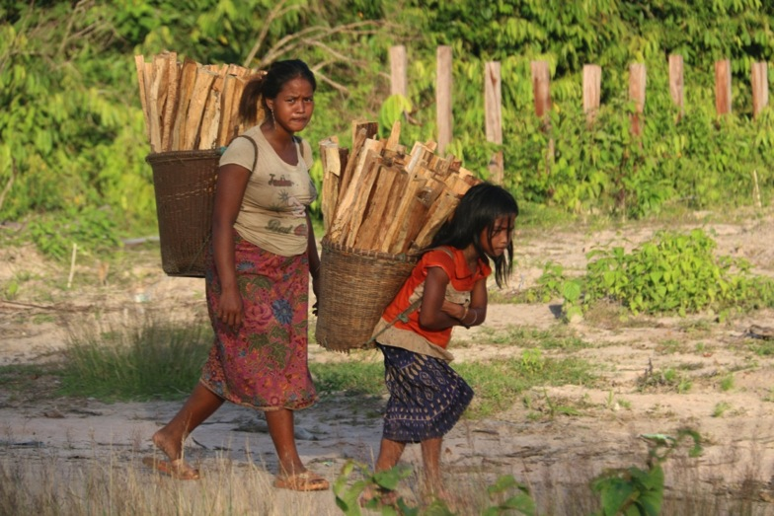
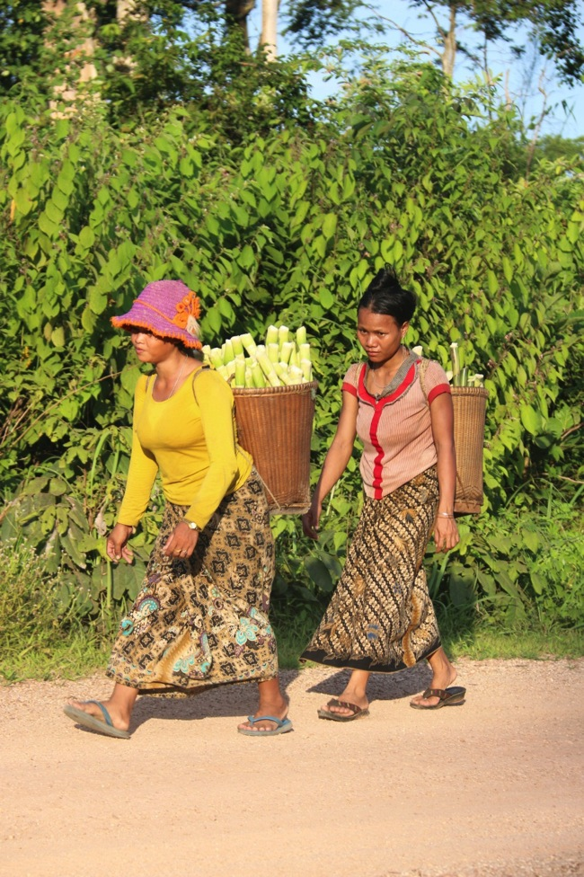
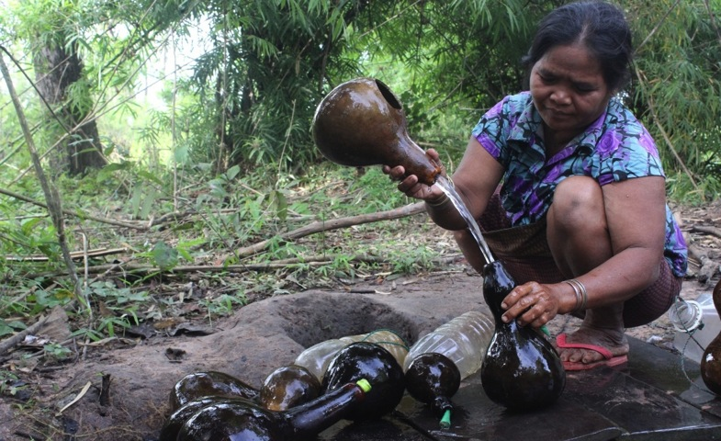
Impacts: Women’s livelihoods

Slide 16
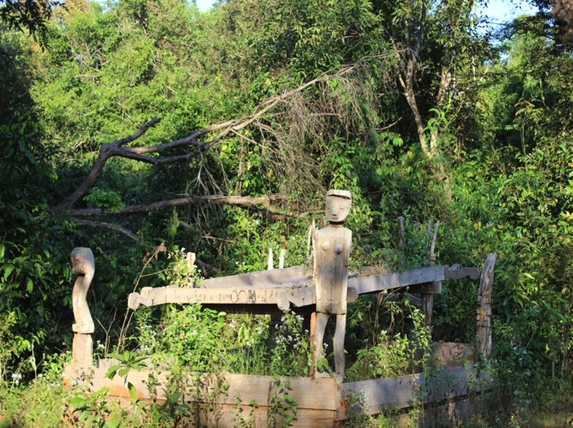
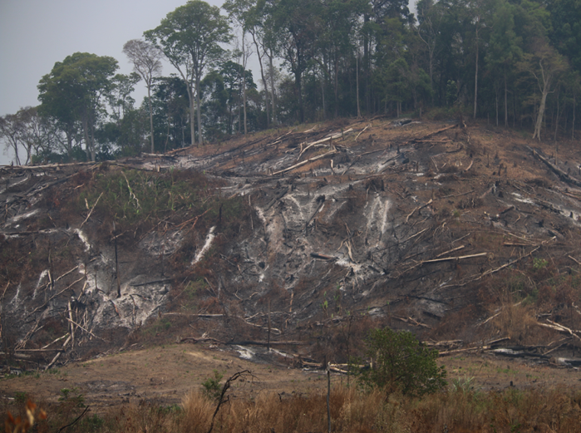
Impacts: Right to practice cultural and spiritual traditions
Sacred sites (spirit forest, burial ground & other sacred sites)
Burial ground in Chay Thom village
Cleared spirit forest in Inn village

Slide 17
Impacts: Right to practice cultural and spiritual traditions
Loss/ destruction of sacred sites
Village | Spirit forest | Burial ground | Chrab | Other sacred place
Inn
Kak
Kam
Kanat Thom
Kresh
Malik
Mass
Muy
Peng
Srae Angkrong 3

Slide 18
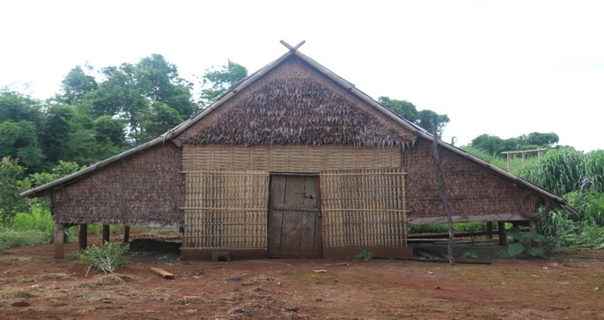
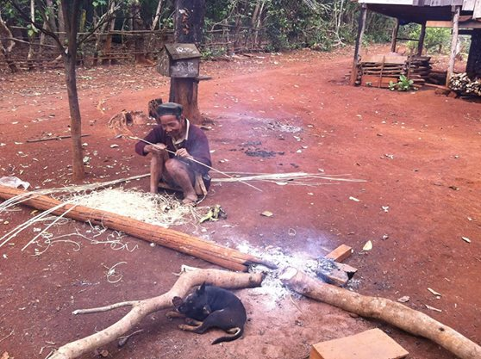
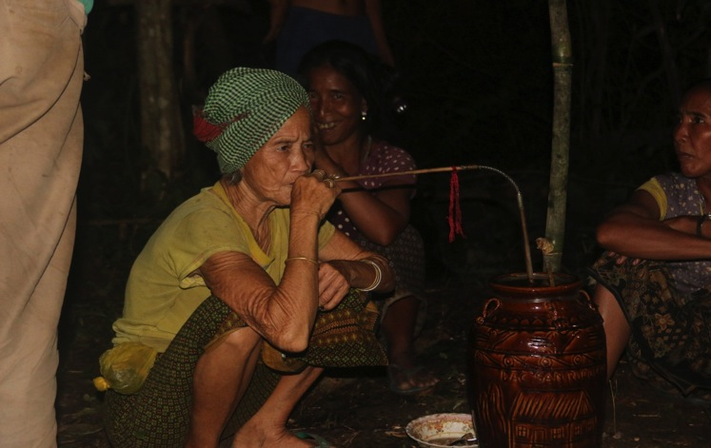
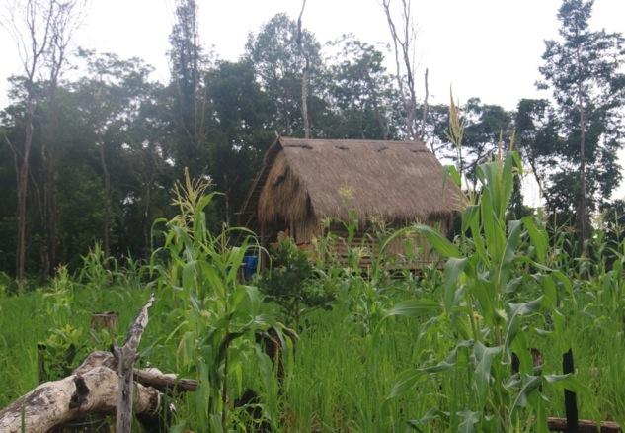
Impacts: Right to practice cultural and spiritual traditions
Traditional activities and livelihood practices
Traditional house (Kreung ethnic group)
Materials for making Kapha
Strew for drinking wine jar
Chamka (shifting cultivation plot)

Slide 19
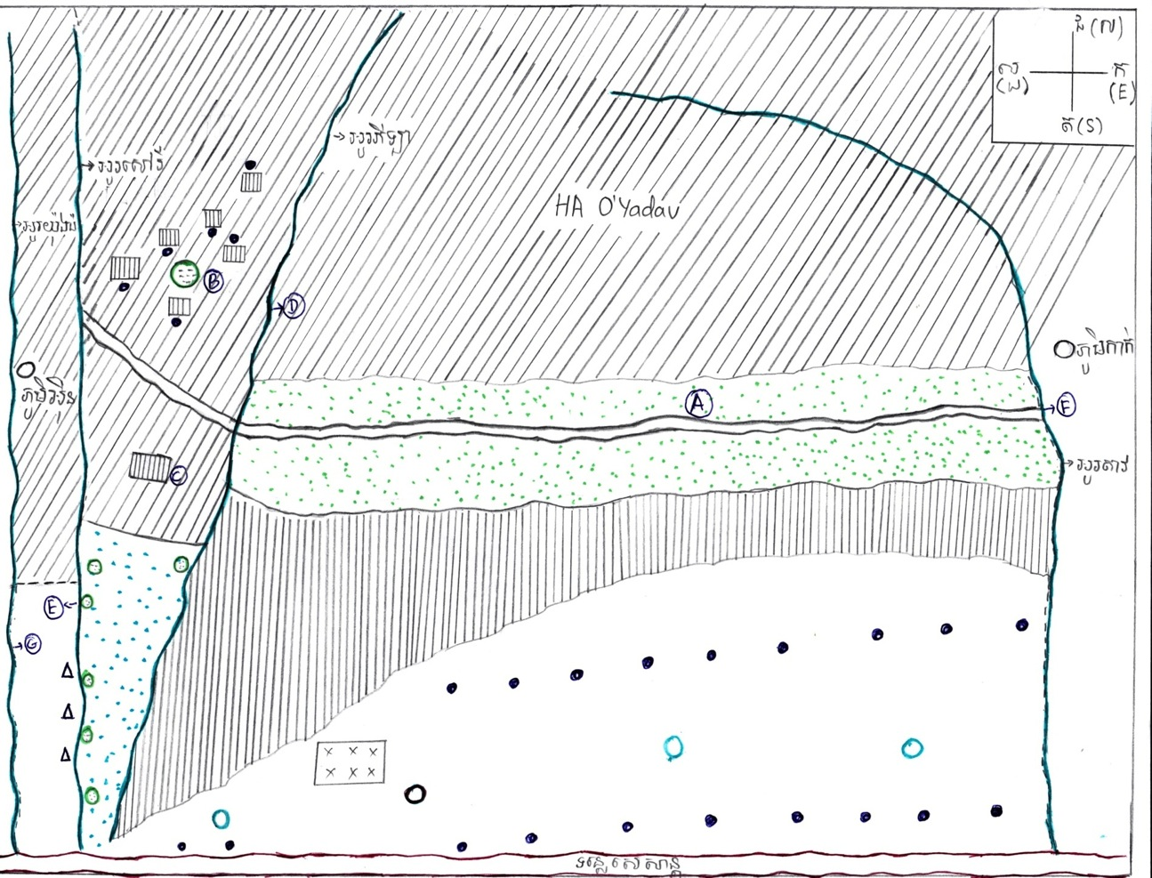
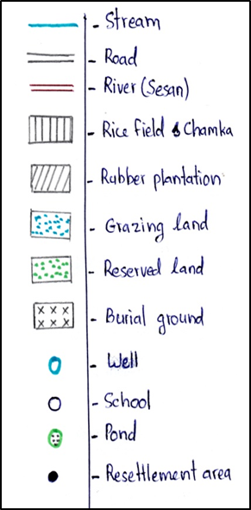
CASE: Talao Village
Hoang Anh
Ou Yadav

Slide 20
Access to remedy
“To get our land back, we made countless complaints with thumbprints to local authorities. The complaint to commune office was rejected. Then, we submitted complaint to district office, but the district authority said they did not have ability to resolve the problem. When our complaint reached provincial level, we were told that land was granted to the company and shown some legal document.”
Villager, Srey Angkong 3 village.

Slide 21
Access to remedy
“I complained [verbally] to the village and commune [chiefs]… They responded that they could not resolve the problem… [For complaint to the court] I do not know how to do it. We are afraid if we skip [some steps], they would bring us to prison…”
-- Villager, Srae Ankrong 1 Village

Slide 22
Complaint to International Finance Corporation's Compliance Advisory Ombudsman (CAO)
In February 2014, 15 villages submitted a complaint to the CAO with the support of a number of NGOs, including Equitable Cambodia and Inclusive Development International.
The complaint highlighted IFC’s financing of HAGL through a financial intermediary, Dragon Capital.
Most community representatives said their communities want their land return.
“The most important thing that I want back is land. It is for feeding our next generations in the future. If we sell land to the company, how can our next generations survive.”
-- Villager, Peng Village.

Slide 23
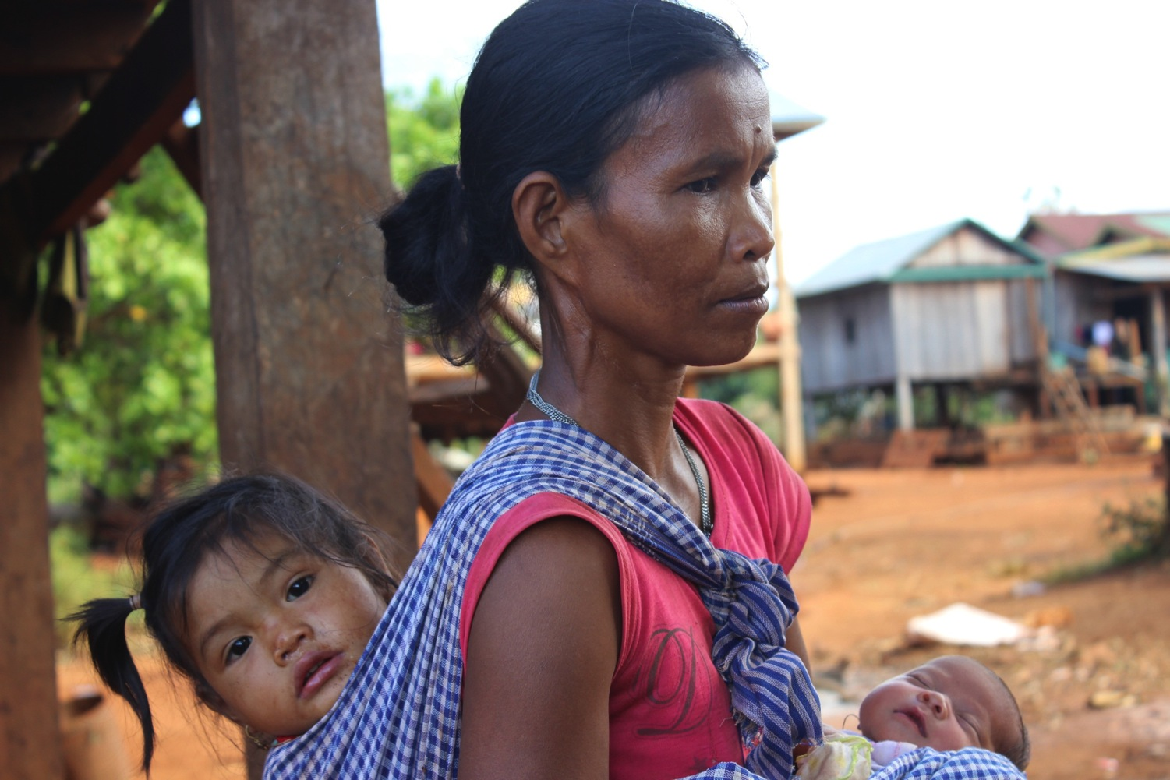
Thanks for your time

