Slide 1
The bank, the borrower, and the bereft Kenya’s Natural Resource Management Project
Christopher Kidd
chris@forestpeoples.org

Slide 2
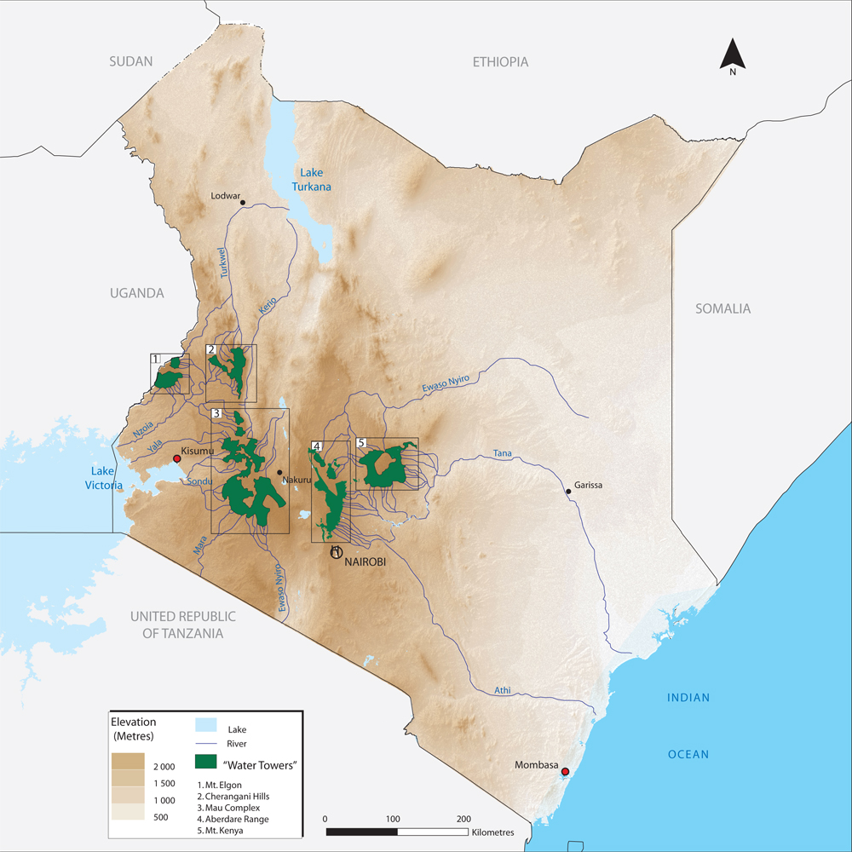
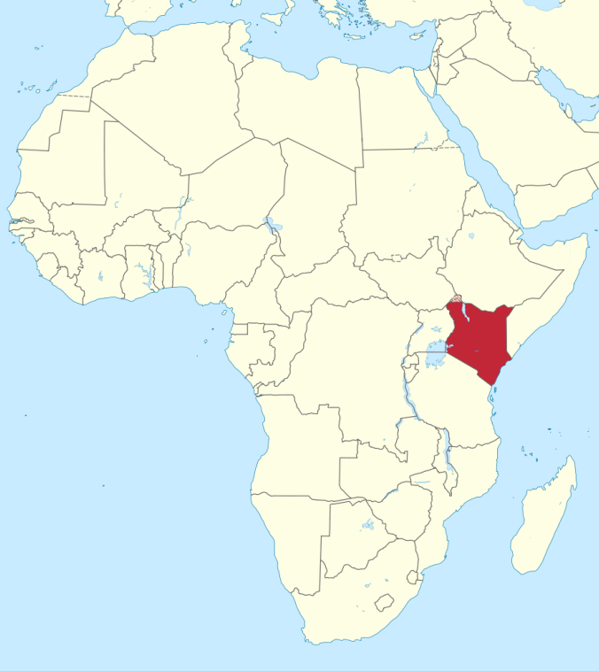
Kenya

Slide 3
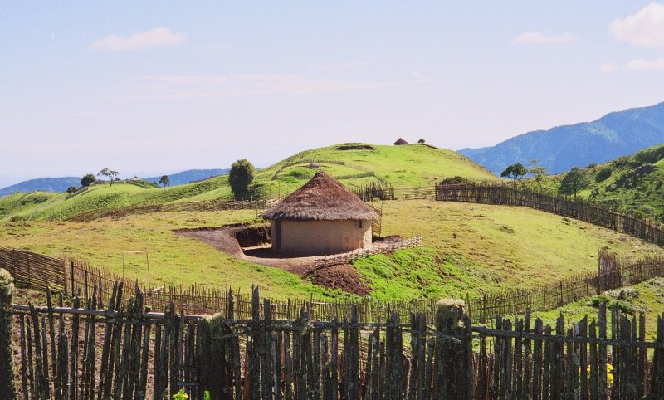
Cherangany Hills

Slide 4
The Sengwer (The Bereft)
Traditionally hunter-gatherer people, whose ancestral lands are located in the Rift Valley province in western Kenya, in and around the forests of the Cherangany Hills.
Keeping bees and gathering wild forest honey has traditionally been an important part of their way of life. Sengwer livelihoods now also include some pastoralism and cultivation.
The 2009 census registered a total population of 33,187 Sengwer.
Dispossession and encroachment onto the traditional lands of the Sengwer (in and around the region of the Cherangany Hills) took place under British colonial rule, and have continued post-independence (1964 Forest Reserve), including with the arrival of internal migrants and internally displaced people.

Slide 5
Government of Kenya (The Borrower)
Evictions of all occupants including traditional forest dwellers
Resettlement schemes – badly designed, inadequate or corrupted before they begin
Compensation as enticement – but neither enough to be fair nor appropriate to meet ancestral rights
Out-dated conservation strategies: e.g. based on idea that
(a) Only the State can own Protected Areas;
(b) Forests must be empty of people to be conserved;
(c) All occupants are squatters, etc.

Slide 6
Natural Resource Management Project (The Bank)
Started in 2007. It’s stated objective was to enhance:
“institutional capacity to manage water and forest resources, reduce the incidence and severity of water shocks such as drought, floods and water shortage in river catchments and improve the livelihoods of communities participating in the co-management of water and forest resources.”
Notes:
Inspection panel report quotes

Slide 7
Specifically component 2 sought to operationalize the newly enacted 2005 Forest Act by helping create a transparent and accountable regulatory and institutional framework in forest resources management i.e. moving from an exclusive Government conservation model to joint management with local communities and the private sector. Among the subcomponents were:
supporting activities to transform the Forest Department into an accountable and semi-autonomous Kenya Forest Service (KFS)
identifying partnership models for community participation and benefit
realigning and demarcating boundaries in selected gazetted forests
supporting the effective implementation of the Resettlement Policy Framework and developing and implementing Resettlement Action Plans.

Slide 8
Indigenous Peoples Planning Framework
The Project’s IPPF sets out a number of obstacles and mitigation measures. It expressly describes these obstacles as challenges that need to be overcome to both ‘achieve project objectives and to comply with international standards (OP 4.10)’.
The associated ‘mitigation measures’ for the NRMP identified by the IPPF include:
Training for GoK and other stakeholders in best practice and techniques for how to work with indigenous peoples to respect the rights, livelihoods, culture and needs of indigenous peoples;
Using the projects as policy test-beds that will, support all necessary steps (land survey and demarcation, registration and documentation) to provide all indigenous peoples in the project area with letters of allotment, group ranch etc;
Not supporting any activities in areas where land is contested without agreement of indigenous peoples through free, prior and informed consultations;
Not engaging in, or supporting, any evictions of indigenous peoples from forests;
Avoid involuntary restrictions on indigenous peoples access to protected areas, in particular to their sacred sites and forests;

Slide 9
2007 Project Design
As required under OP4.10, applicable Bank policy at the time, the Broad Community Support (BCS) of the residents of the Cherangany Hills was judged to be present.

Slide 10
Restructuring
On June 10, 2011, the Project was restructured and the development objective was redefined to adjust Project outcomes to those that could realistically be achieved during the life of the Project. With this restructuring, Management claimed that resolving comprehensive land issues was beyond the remit of the Project, stating to the Board that the Project “would not be able to implement the land related commitments”
And therefore that the Project would no longer aim to:
“1) hasten the provision of titles for land presently occupied and used by the communities in the Project areas including support for necessary steps, such as land survey, demarcation and registration of titles;
2) establish a comprehensive strategy to rehabilitate livelihoods of evicted people...; and;
3) offer assistance within the land restitution process to indigenous peoples to claim all lands over which they have lost control between 1895 and 2002 .”
All critical elements of the project for the Sengwer and IPPF.

Slide 11
2011 Project Re-design
Importantly, this substantial re-structuring, including the removal of the land titling elements favored by the communities, happened without Broad Community Support being required again.

Slide 12
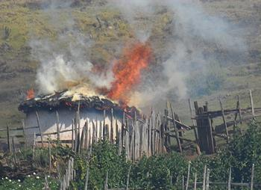
Community Experience
The Kenya Forest Service (KFS) repeatedly attempted to forcibly evict Sengwer communities living in Embobut, including by regularly burning their houses, food and other possessions (e.g. in 2007, 2008, 2009, 2010, 2011, 2013) causing inestimable trauma (including to the children present), increased risk of health problems from exposure to rain and cold plus loss of food, and increased overall poverty and reduced access to education resulting from burnt school uniforms and textbooks and loss of income to pay school fees.
This resulted in a group of requesters
submitting a request to the Inspection
Panel in January 2013

Slide 13
Inspection Panel
The requesters chief concern was that none of the mitigation measures were adequately implemented in the NRMP, and many were not implemented at all. This constituted a significant breach of Bank Policy, since they were identified by the IPPF as key mitigating measures, and their implementation was therefore required to maintain compliance with OP 4.10.
Furthermore, the Bank’s Restructuring Paper was one key way this lack of implementation happened since it removed key activities related to securing their land rights. Activities which were of fundamental importance to the Sengwer. The way in which this restructure was conducted was in breach of Bank Policy in that there was a failure to ensure broad support for the restructured project through appropriate free, prior and informed consultations.

Slide 14
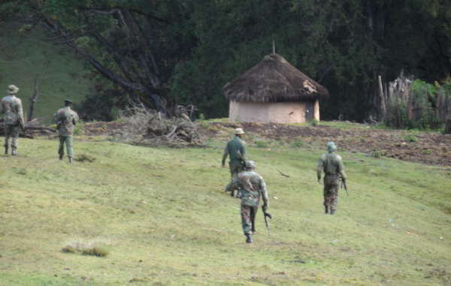
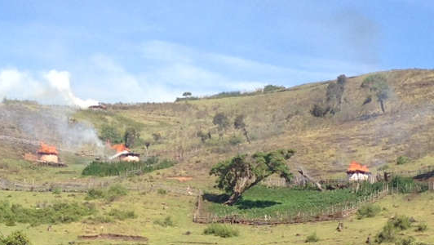
2014

Slide 15
What went wrong?
Failure to meet policy requirements
In project design and implementation, the World Bank failed to adequately ensure compliance with the requirements of OP 4.10, especially BCS through FPICon.
In the involuntary resettlement related activities World Bank failed to adequately ensure, compliance with the requirements of OP 4.12
Failure to ensure adequate risk assessment
The Bank failed to ensure that the NRMP did not contravene Kenya’s international human rights commitments, specifically those relating to the rights relating to indigenous peoples, land and natural resources.
The Bank failed to assess, as a part of its project due diligence, whether human rights issues in Kenya impede compliance with Bank Policies.
Notes:
Tom’s document

Slide 16
Inspection Panel Outcome
The Panel found that evictions were not directly supported as part of the NRMP. However, it noted that more attention should have been given from the outset to better identify and mitigate the risk that evictions might occur and that the correct application of the safeguard policies may have prevented or mitigated these harms. The Panel also found an inadequate institutional analysis of KFS.
The Panel Chairperson, Eimi Watanabe, noted that “the NRMP did not take advantage of the opportunity to incorporate indigenous people in the management of forest resources, which would have contributed towards the Project’s goals while also strengthening IP’s historic land and customary rights.”
Despite this, Management in turn refuted any such inadequacies in the project design or implementation and proposed a weak action plan.
The Board met last week and demanded more tangible actions and an update report in 6-12 months.

Slide 17
What would have happened under this project if the newly proposed ESS7 was applicable instead of OP4.10?

Slide 18
First let us assume..
The project is not funded under a Program-for-Results instrument
The project is not funded under a Development Policy Loan
The project is not a medium / low risk project being funded through a financial intermediary
The project is not using a ‘borrower system’ (national law)

Slide 19
IF ESS7 was applied in full
If ESS7 was applied, in theory the Government of Kenya would have needed to obtain the FPIC of affected IPs for its activities in Cherangany Hills and could not have resorted to forced evictions. This is a substantive improvement. However..
If ESS7 was applied, reliance by the Bank in its due diligence on the Government of Kenya for the E&S assessment, combined with deferred appraisal (i.e. no need for a comprehensive IPP prior to project approval) would mean that it would be unlikely that the complex land tenure issues and potential adverse impacts on the Sengwer would have been properly identified and addressed.
Notes:
natalie

Slide 20
The ‘alternative approach’
The inclusion of an option (the alternative approach) would allow the Kenyan government to opt-out of ESS7, meaning they would not have to meet the standards even if the Bank judges indigenous peoples are present.
“[ESS 7] recognizes that Indigenous Peoples…are distinct from mainstream groups in national societies and often are disadvantaged by traditional models of development…they are among the most economically marginalized and vulnerable segments of the population. Their economic, social, and legal status frequently limits their capacity to defend their rights to, and interests in, land, territories and natural and cultural resources…
Draft Environmental and Social Standard 7 - Indigenous Peoples
"The World Bank‘s intention to allow our governments, which have marginalized our communities for decades, to decide whether we are indigenous or not would severely undermine our fundamental human rights and weaken the limited protections we currently have. This approach would completely contradict the growing recognition of our rights, and must not be allowed to happen.”
Adrien Sinafasi Makelo, Democratic Republic of the Congo

Slide 21
Under the ‘alternative approach’
The Government of Kenya may have successfully argued that it should apply the "alternative approach” and would have therefore been able to circumvent the rights of the Sengwer.
In this situation, only ESS1-6 and 8-10 would apply. How would these standards have impacted the Sengwer and how would they impact other indigenous peoples under similar circumstances?
Let’s look at three, briefly. ESS1 on Environmental and Social Assessment; ESS5 on Land Acquisition, Restriction on Land Use and Involuntary Resettlement; and ESS6 on Biodiversity Conservation and Sustainable Management of Living Natural Resources

Slide 22
ESS1
The overall increase in flexibility in implementation undermines results (inclusion of much more ‘where the Bank judges necessary’, or ‘where feasible’, or ‘where applicable’) by placing more responsibility on staff without any plan to show how staff will be supported to follow through on any of this.
ESS1 only contains a vague reference to assessing risks to land and natural resource tenure without any objectives or requirements attached, other than the vague mitigation hierarchy - clearly not enough to respect and safeguard indigenous rights in line with UNDRIP.

Slide 23
ESS5
ESS5 has as its first objective “To avoid involuntary resettlement or, when unavoidable, minimize involuntary resettlement by exploring project design alternatives.” and “To avoid forced eviction”.
This is NOT a strict prohibition in line with international law on the removal of indigenous peoples from their lands, but a preferred ‘avoid’ where possible.
In its exclusions (ie. Where the standard is simply not applied) include:
(d) Land titling/regularization activities; or
(e) Regulation or planning of natural resources or land use on a regional or national level to promote sustainability.
ESS5 does not require FPIC or provide any protection for land tenure systems. It presupposes resettlement will occur, so the best it could have done, if well applied, is to resettle the Sengwer to relocation sites and provide compensation, livelihood support, etc. But it, would not have been able to uphold indigenous rights in line with UNDRIP and is not tailored to respect their collective attachment to land and resources or their livelihood practices and systems, etc.

Slide 24
ESS6
Current OP4.04 on Natural Habitats recognizes areas recognized as protected by traditional local communities as ‘critical natural habitats’ which require the highest standard of protection from degradation. In countries where indigenous peoples are not recognized, this policy has been useful for protecting lands conserved or managed by forest peoples.
ESS6 only makes a vague reference to considering the use of natural resources by indigenous peoples’ in social assessments so is not a useful tool in this context. It removes indigenous sacred sites from critical habitats.

Slide 25
Implications for the Inspection Panel
The new policy proposals risk undermining the Panel as the new flexibility makes judging a violation of policy harder, and provides more room for Bank management to argue that what was judged ‘necessary’ was a fair judgement with available facts.
Early disbursement undermines the leverage of the Bank in applying the limited sanctions it has at hand in cases of violation of policy.

Slide 26
Conclusion
Ultimately the current draft ESSs:
Empower a borrower who has shown itself to violate the rights of the beneficiaries
Empower a management who has shown an inability to recognise, understand, and act upon the situation of the beneficiaries, and an inability to act on the assessment of the Bank’s Inspection Panel findings
And disempower the only form of recourse the beneficiaries have in the event that the Bank and the Borrower do what they have historically done!

Slide 27
As a result it is more likely that this would happen again under the current ESSs. The ESSs would have been:
Less likely to prevent the human rights violations from taking place &
Less likely to to find redress after the fact.
This does not suggest that the proposed ESS can possibly lead to the improvement in Bank performance in social and environmental outcomes that is so desperately needed.

