Slide 1
THE WORLD BANK AND NAM THEUN 2 IN LAOS

Slide 2
Sombath Somphone
Acknowledged founder/leader of Lao civil society
Ramon Magsaysay award winner
Forcibly disappeared from the streets of
Vientiane in December, 2012 after leading a CSO forum that brought attention to issues of land grabbing and land rights in Laos.

Slide 3
Lao People’s Democratic Republic
Second most repressive government in East Asia (following North Korea).
Highly corrupt government (160/175 in 2012) according to Transparency International Corruption Perception Index.
No independent media, no human rights organizations, no independent farmer or labor organizations.
Local CSOs strictly controlled, no open questioning or advocacy related to Government of Laos (GOL) policy tolerated.
Project impacted communities not allowed to protest or complain.

Slide 4
Nam Theun 2 Hydropower Project
1070MW US$1.45 billion trans-basin diversion project, largest foreign investment in Laos at the time. Impacts two rivers.
Operated by Nam Theun Power Company (NTPC)—French, Thai and Lao companies.
Almost all electricity exported to Thailand. GOL portion of revenues to be used for nationwide poverty alleviation programs.
Approved for World Bank support in 2005, construction completed in 2010. The World Bank was the key ‘dealmaker.’ Most financing came from private sources.
The Bank justified its support based on “poverty alleviation” criteria and NT2’s “state of the art” social and environmental mechanisms and monitoring.

Slide 5
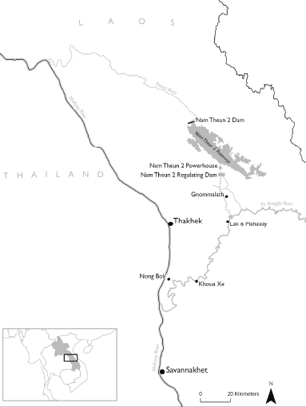
The Nam Theun 2 Hydropower Project in central Laos

Slide 6
Three key social and environmental issues:
Reservoir flooding requiring resettlement of over 5000 indigenous people
Biodiversity protection in the adjacent Nakai-Nam Theun National Protected Area.
Downstream Impacts in the Xe Bang Fai and Nam Theun river basins--120,000 – 155,000 people (including indigenous people).
All World Bank safeguard mechanisms triggered.

Slide 7
Project Monitoring – the International Social and Environmental Panel of Experts (the POE)
Active since 1997 in monitoring social and environmental objectives and issuing annual reports.
Especially important due to the lack of independent local civil society or monitoring.
In its early years the involvement/endorsement of the POE was cited by the World Bank as providing important justification for the project.

Slide 8
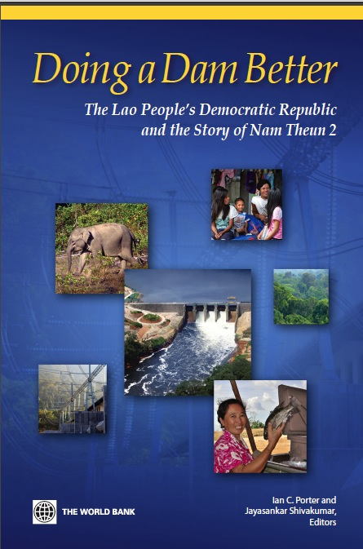
What has happened?
The World Bank, other project financiers and NTPC have promoted an ongoing narrative of success.
Active PR campaign, “Doing a Dam Better” published soon after project completion.
World Bank/NTPC and the GOL have had tight control of the narrative due to restrictions in Laos.

Slide 9
NT2 as a model?
The World Bank has claimed that success of NT2 justifies further Bank lending for large hydro worldwide--due to its poverty alleviation potential at a time of growing concern about climate change, calling hydropower ‘clean energy.’

Slide 10
Where does the POE stand?
“Nam Theun 2 confirmed my longstanding suspicion that the task of building a large dam is just too complex and too damaging to priceless natural resources.”
-- Dr. Thayer Scudder, New York Times, August 24, 2014.
Dr. Scudder, a prominent POE member/hydropower expert has came out against NT2 saying it had failed to meet its social and environmental goals and describing it as his “final disappointment” in a long career of trying to make hydropower projects work better.
Recent POE reports confirm it is not just Dr. Scudder but the entire POE that has developed substantial criticisms of NT2.

Slide 11
Ongoing problems with resettlement on the Nakai Plateau
Failure to fully restore or improve livelihoods.
Short term income gains due to the unsustainable harvesting of tropical hardwoods in the protected area (at expense of conservation goals).
Ongoing land fertility/production issues.
Emphasis on infrastructure (houses, schools, roads, etc.) rather than livelihood/income issues.
Active engagement/involvement of POE has helped keep things from being even worse.

Slide 12
Conservation Debacle
One of the most important conservation areas in mainland Southeast Asia severely impacted. NT2 conservation funds used to build roads—facilitating trade in rare hardwoods and wildlife.
NT2 funded Watershed Management Protection Agency so riddled with corruption and malfeasance that the POE is now calling for its complete dismantling and restructuring.

Slide 13
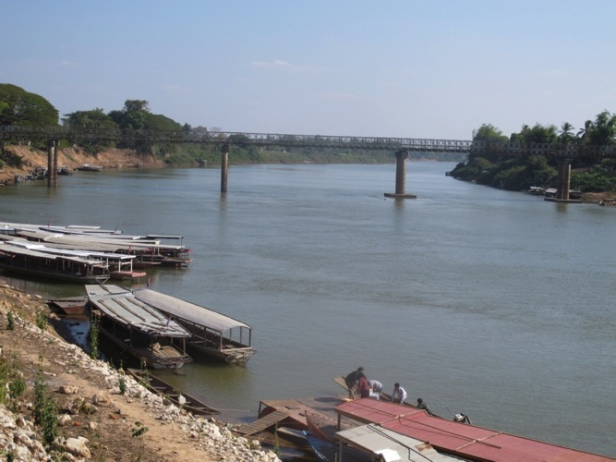
Downstream Areas: Xe Bang Fai River Basin
Downstream Compensation Program terminated prematurely when allocated funds ran out in 2013—before restoring livelihoods.
World Bank was supportive of the early “handover” to GOL, the POE was not.

Slide 14
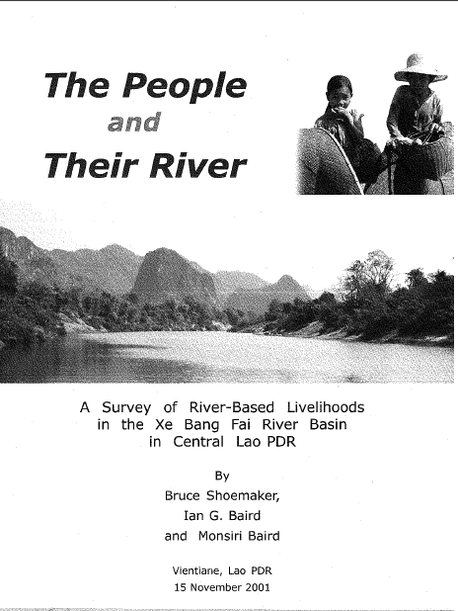
The People and Their River Revisited-2014
Follow-up on 2001 study which documented the livelihood links people have to the Xe Bang Fai.
Three Lao-speaking researchers affiliated with U of Wisconsin-Madison—Ian Baird, Bruce Shoemaker and Kanokwan Manoram.
Three weeks of independent fieldwork in January, 2014.
Over 100 interviews conducted all along the Xe Bang Fai.

Slide 15
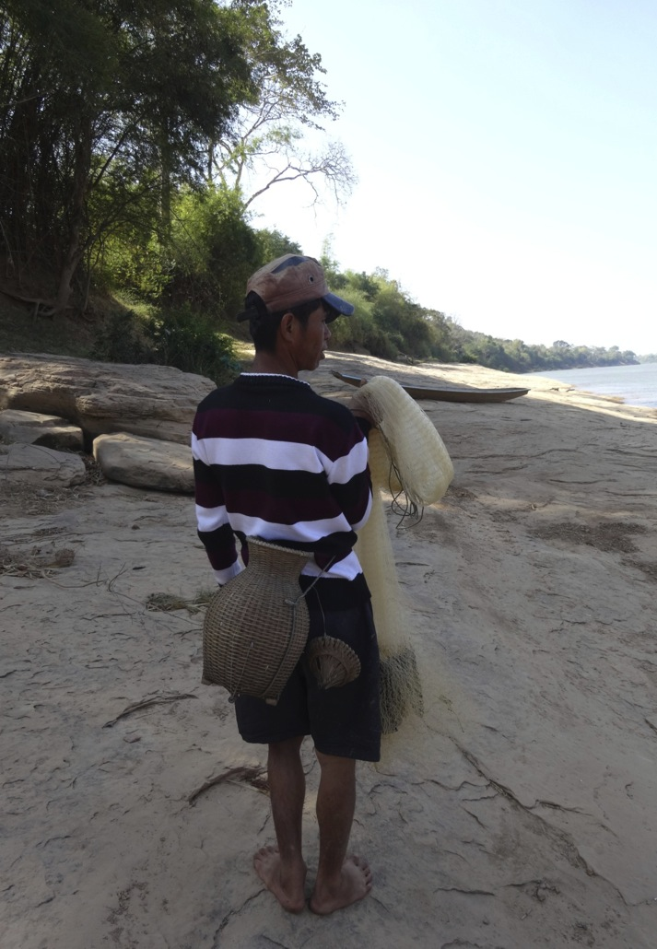
STUDY RESULTS:
Interviewees report significant impacts from NT2 :
Dramatic reductions in fish catch --previously the main cornerstone of local livelihoods.
Loss of riverbank gardens due to fluctuating water levels.
Impacts on water quality and supply.

Slide 16
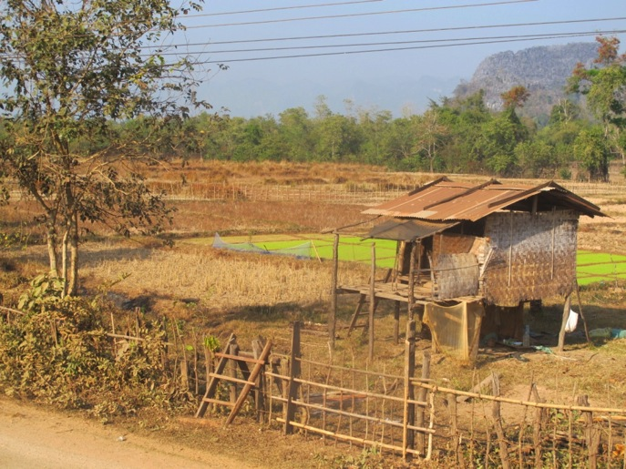
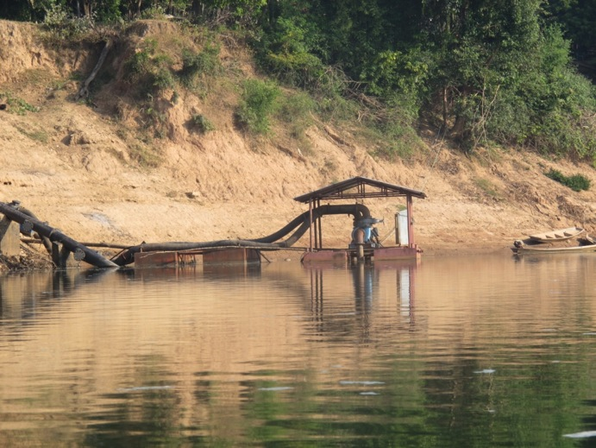
Loss of rainy-season rice cultivation due to excessive flooding in the Xe Bang Fai.
NT2’s Downstream Compensation Program (DSP) was inadequate -- over 90% see it as NOT making up for fisheries-related losses and other problems.
Promotion of dry season pump irrigation has failed to compensate people for the loss of rainy season rice cultivation due to high costs for electricity, fertilizer, etc.

Slide 17
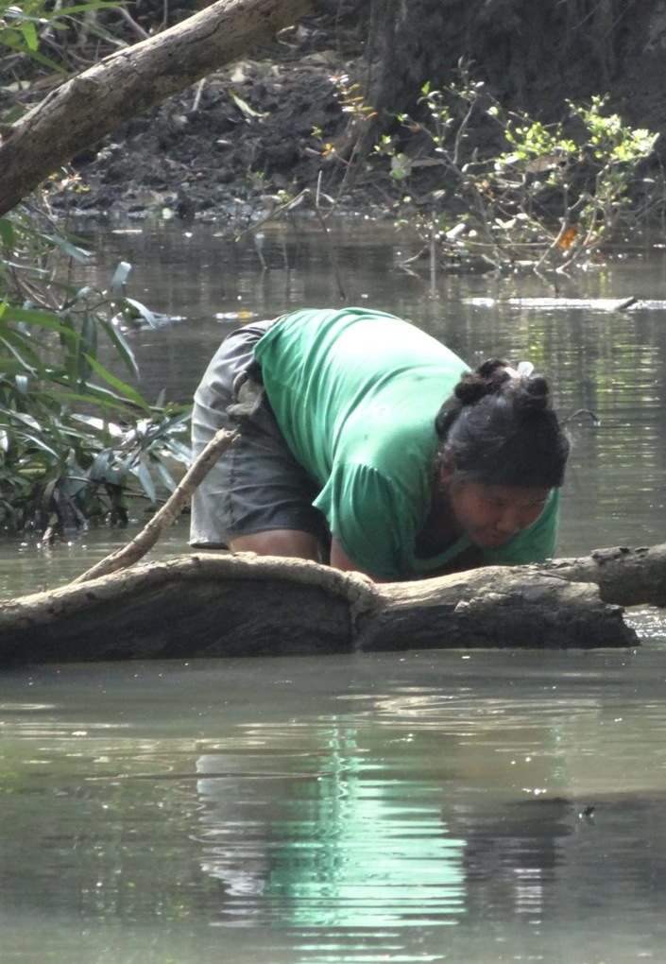
Women and poorer/indigenous households especially impacted—and less able to take advantage of compensation programs.
People left worse off from just below the dam all the way down to the Mekong confluence.
Reliance on one time payments and risky development initiatives. But impacts will continue throughout the life of the project.

Slide 18
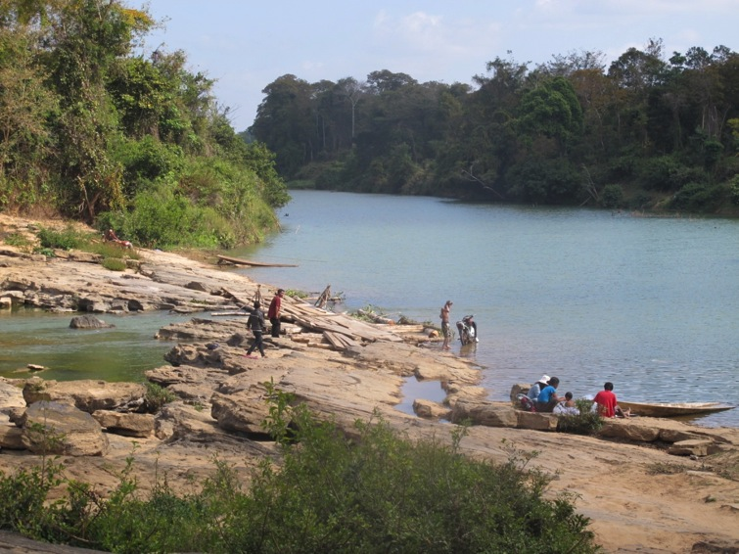
KEY POINTS:
No substantive compensation for fishery related losses.
Following “handover” little or no GOL follow-up—compensation programs quickly terminated. Even though developers and GOL are projected to earn several billion dollars.
Grievance process not functioning—many villagers reported fearing arrest if they complain or speak out against the project.

Slide 19
CONCLUSIONS
Further independent assessment of the situation is needed.
Evidence to date—both our study and from the POE-- points to a failure of NT2’s poverty alleviation goals and objectives.
The World Bank failed to insure the private developers were responsible for the full costs of mitigation and compensation—externalizing costs.
The World Bank’s attempt at creating an “island of accountability” within an authoritarian and corrupt political environment has failed and was not a realistic goal in any case.
Calling NT2 a model justifying further World Bank support for large hydro is premature and is not warranted by the evidence.

Slide 20
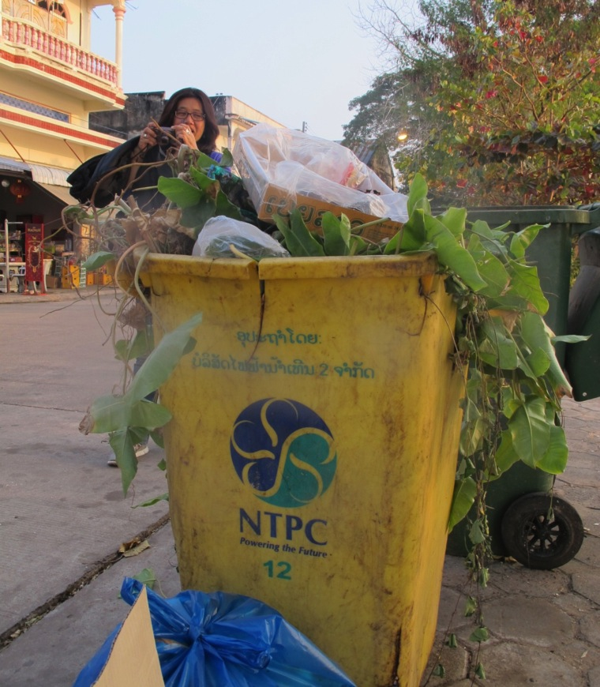
THE END

